Slide 1

AL-FARABI KAZAKH NATIONAL UNIVERSITY
Lecture 7:
The Importance of Teaching Vocabulary
Senior lecturer:
PhD doctor Aliakbarova A.

Slide 2
All languages have 3 main parts:
Words (vocabulary)
Rules (grammar)
Sounds (pronunciation)
How many words does a typical native speaker know?
20 000 (Goulden, Nation, Read, 2000)

Slide 3
friendship friends
Friend
friendly friendless
friendliest

Slide 4
Some opening questions
1. How many words do you think there are in the English language?
1 000 000 (Stanford research group, 2008)
350 000 (Oxford English Dictionary)

Slide 5
High frequency words
700 key words = 94% of day to day spoken use
Meaning words VS Grammar words
Most common 20 words in English
be of that he
the you we this
and it not for
to in they on
a have do but

Slide 6
Grammatical words
Articles Auxiliary Preposition Pronoun
verbs
a is of he
an was in her
the do for it
have

Slide 7
Meaning words (550)
Nouns Verbs Adjectives
person think long
time say old
question want high
You need to be able to identify nouns, verbs, adjectives
Sentence: “The small child sat next to his young mother”.

Slide 8
Why is Vocabulary Instruction Important?
In reading, vocabulary knowledge is essential to comprehending text.
When students do not understand at least 90% of the words in a text, they do not adequately understand what they read.

Slide 9
Teaching active and passive vocabulary
Teaching passive vocabulary is important for comprehension – the issue of understanding another speaker needs the listener to have passive vocabulary. This is also called receptive knowledge of English.
Active vocabulary contains the words a student can understand and manipulate in order to use for their own personal expression. This is called productive knowledge of English.

Slide 10
How many times do I need to see or hear a word before I remember it?
Memorizing words FAST by using flashcards
- categorise your flashcards by nouns, verbs & adjectives
write the English word on the one side, write the translation on the other
use different coloured pens (write nouns in blue, verbs in red, adjectives in green)

Slide 11
Word association technique
If the words are stored together in commonly used phrases and sentences, they are more readily absorbed. Putting words with collocational partners in this way helps the students to relate connected words together.

Slide 12
Visual techniques
Images can link to words; words can also be linked to other words, for example, a student might link the word ‘car’ with ‘garage’ and with ‘mechanic’.
This idea of engaging the other senses can also help with developing a kind of semantic map where words are listed which relate to each other, which creates a situation where one word reminds the student of another.

Slide 13
Brainstorming
The key word should be written up in the middle of the board and the new vocabulary relating to it can be written around it. Use colourful pens if writing on a whiteboard to emphasise different word types.

Slide 14
Matching columns
A useful way to test if students have understood the meanings of this new vocabulary is to ask them to match new words from one column with definitions from another column.
The new words are numbered in column one, and the definitions are mixed up and lettered in column two.

Slide 15
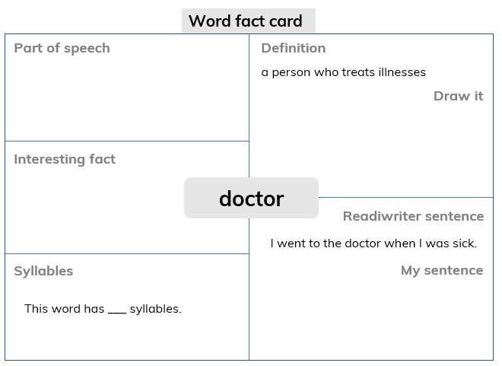
Graphics organisers
A simple graphic organiser can be an effective method to help students master their knowledge of new words.

Slide 16
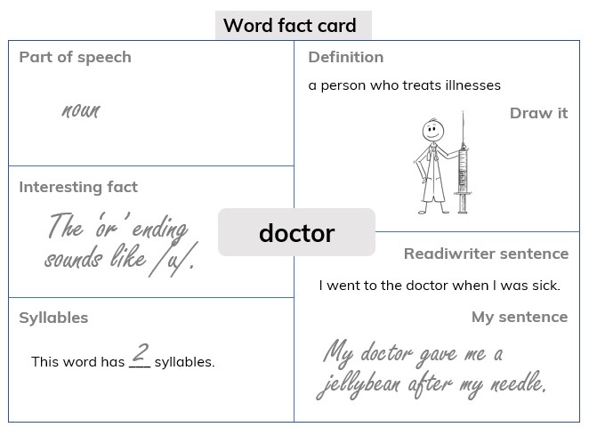
Graphics organisers

Slide 17
Idioms
Idioms are common features of every day language and are an important part of advanced language use and a major step towards fluency.
Idioms can be introduced to the ESL classroom through authentic reading materials such as informal text from magazines, low-brow newspapers, letters, comic strips, pop songs, dialogue from radio or television, popular films and soaps.

Slide 18
Collocations
Lexical collocations are made up of combinations of lexical items such as nouns, adjectives, adverbs and verbs. Examples of lexical collocations are: dripping tap, hopelessly addicted, cook dinner, happy birthday, great expectations.
More idiomatic phrases such as ‘practise makes perfect’, ‘it’s a high mountain to climb’ or ‘it glides like a knife through butter’ are good for fluency and help with understanding commonly used similes.

Slide 19
References
1. Кунанбаева С.С. Современное иноязычное образование: методология и теории. - Алматы, 2005.-264с.
2.Гальскова Н.Д. Современная методика обучения иностранным языкам в школе. – М., 2000.
3.Гальскова Н.Д., Никитенко З.Н. Теория и практика обучения иностранному языку. Начальная школа. Методическое пособие.- М., 2004.
4.Кунанбаева С.С. Теория и практика современного иноязычного образования. Алматы. 2010. 344с
5. К.В. Фокина, Л.Н. Тернова, Н. В. Костычева. «Методика преподавания ин.языка», Высшее образование. 2008.
6. Ideas for using flash cards. https://www.youtube.com/watch?v=X9KebTgfLJI

